Slide 1
Agenda 11/1
Discussion on Readings/Viewings
Anatomy of the Web & Webpage
Building our first Chrome Extension!

Slide 2


Reading/Viewing Discussion
Perverting “Technological Correctness”

Slide 3
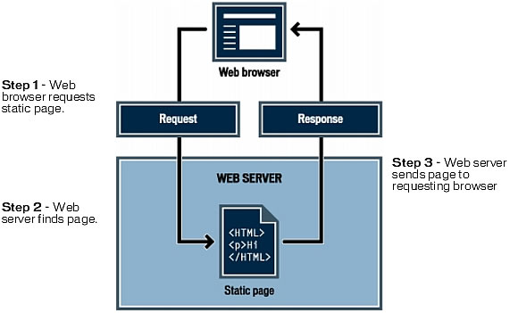
Anatomy of the Web
HTML (Hyertext Markup Language) = Webpage

Slide 4
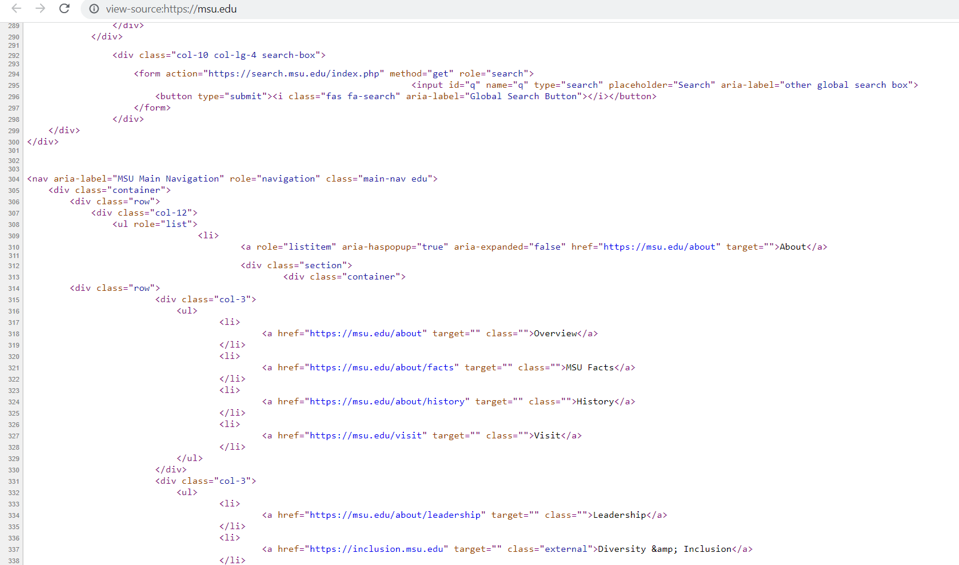

The Browser
A computer program the ‘formats’ HTML code of us too see

Slide 5
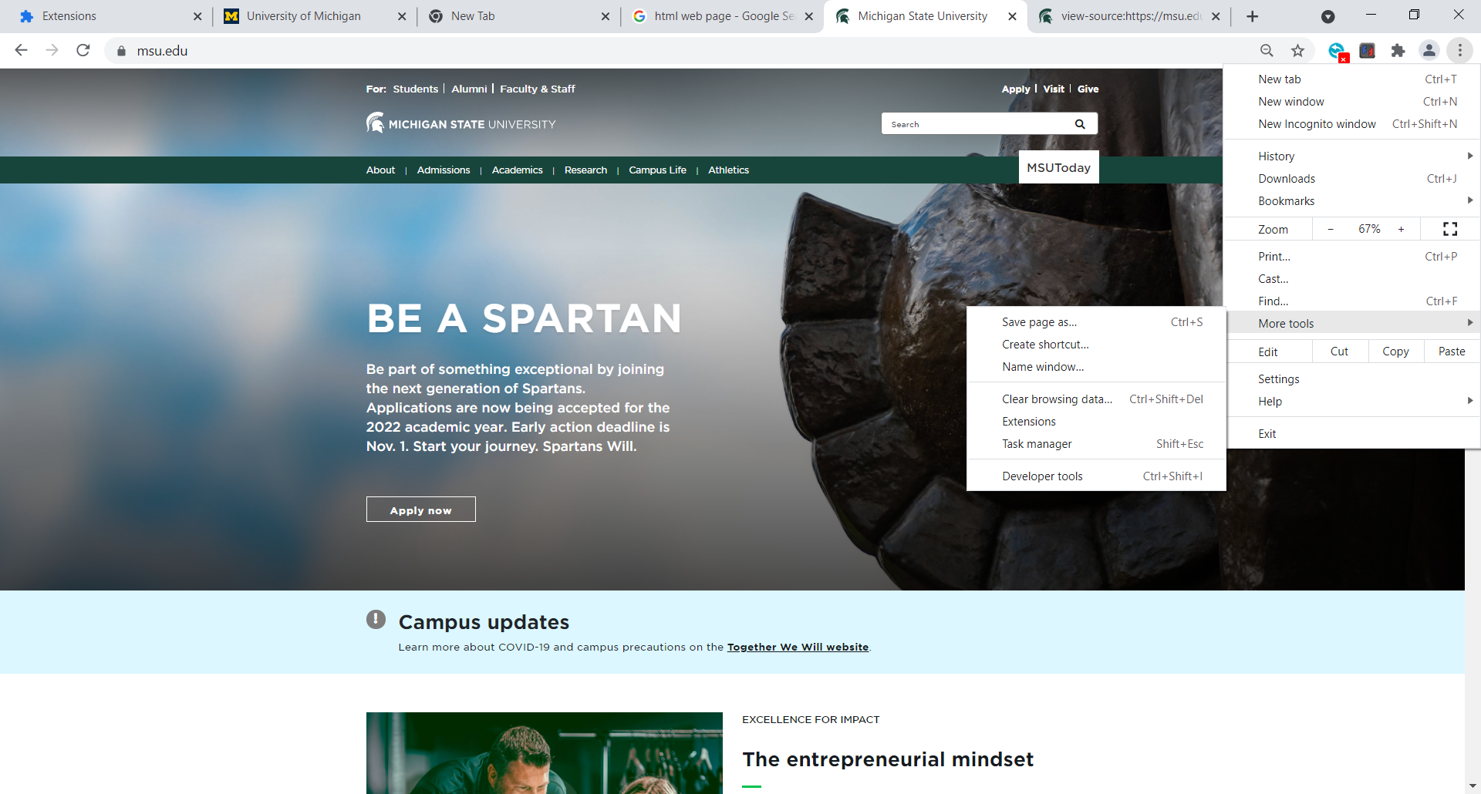

The Browser
Looking under the hood a.k.a Developer Tools

Slide 6
The Anatomy of a Webpage

Slide 7
Tools Needed
Download:
Google Chrome: https://www.google.com/chrome/
Sublime Text Editor: https://www.sublimetext.com/

Slide 8
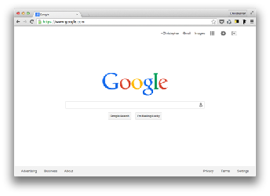


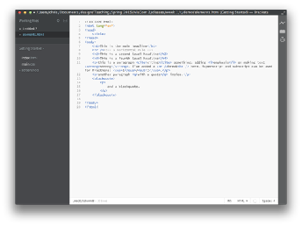

file format = .html

Slide 9
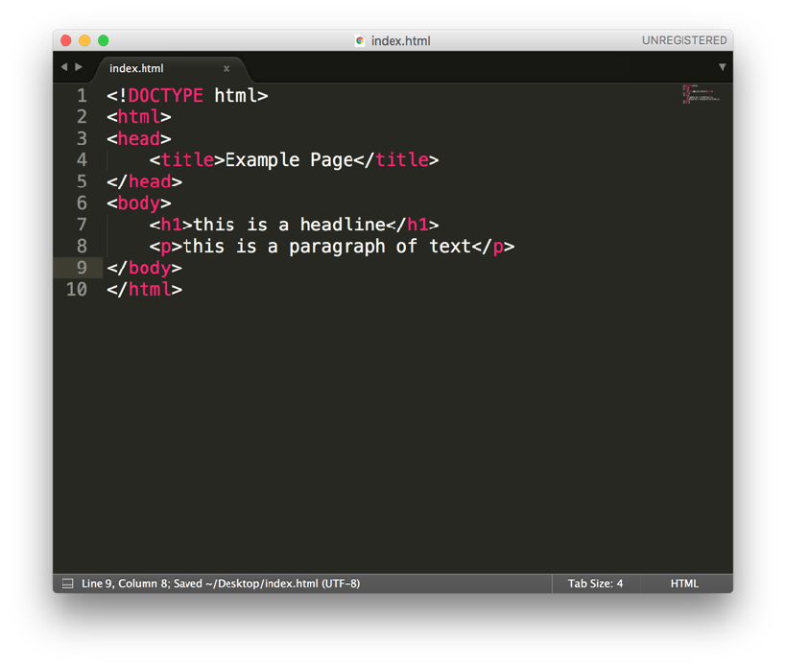

Slide 10
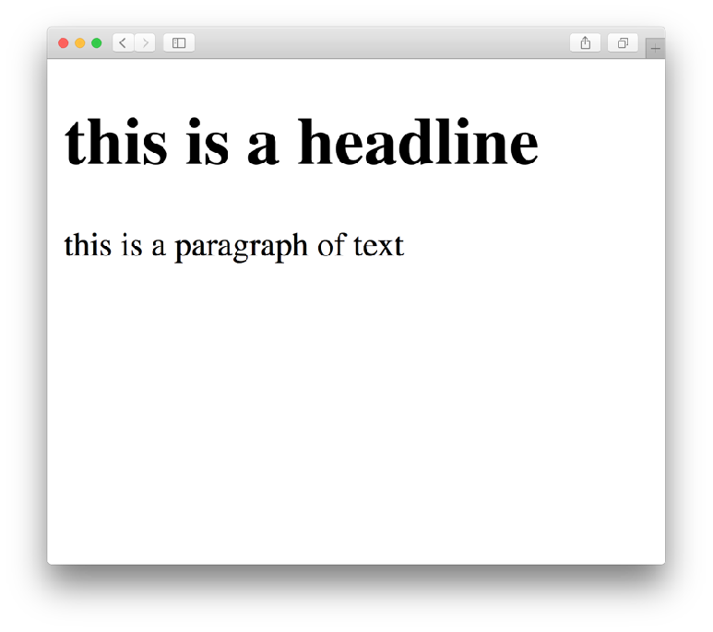
HTML = Hyper Text Markup Language
<html>
<body>
<h1>
this is a headline
</h1>
<p>
this is a paragraph of text.
</p>
</body>
</html>

Slide 11
HTML = Hyper Text Markup Language
<! DOCTYPE html>
<html>
<head>
<title>
Example Page
</title>
</head>
<body>
<h1>
this is a headline
</h1>
<p>
this is a paragraph of text.
</p>
</body>
</html>

Slide 12
HTML = Hyper Text Markup Language
HTML Tags
<h1>headline 1</h1>
<h2>headline 2</h2>
<p>paragraph</p>
<sup>superscript</sup>
<sub>subscript</subscript>
<br />
<hr />

Slide 13
HTML = Hyper Text Markup Language
<em>emphasis</em>
<strong>strong</strong>
<blockquote>block quote</blockquote>
<q>quote</q>
<ins>inserted text</ins>
<del>deleted text</del>

Slide 14
HTML = Hyper Text Markup Language
Attributes
attribute
name
<p style=“color: red”>my paragraph</p>
attribute
Value

Slide 15
HTML = Hyper Text Markup Language
Attributes
attribute
name
<body style=“background-color: pink”>
attribute
Value

Slide 16
HTML = Hyper Text Markup Language
Attribute Colors: https://www.w3schools.com/html/html_colors.asp

Slide 17
HTML = Hyper Text Markup Language
Images
<img src=“http://40.media.tumblr.com…” />
<img src=“partylisa.gif” />

Slide 18
How to change HTML through the browser?
1. Open “Developer Tools” in Chrome 2. Find the HTML source code under “Element” 2. Locate HTML tags like h1, h2, p etc. and change them manually

Slide 19
JavaScript
JavaScript is a scripting or programming language that allows you to implement complex features on web pages — every time a web page does more than just sit there and display static information for you to look at — displaying timely content updates, interactive maps, animated 2D/3D graphics, scrolling video jukeboxes, etc. — you can bet that JavaScript is probably involved.
-Mozilla Foundation

Slide 20
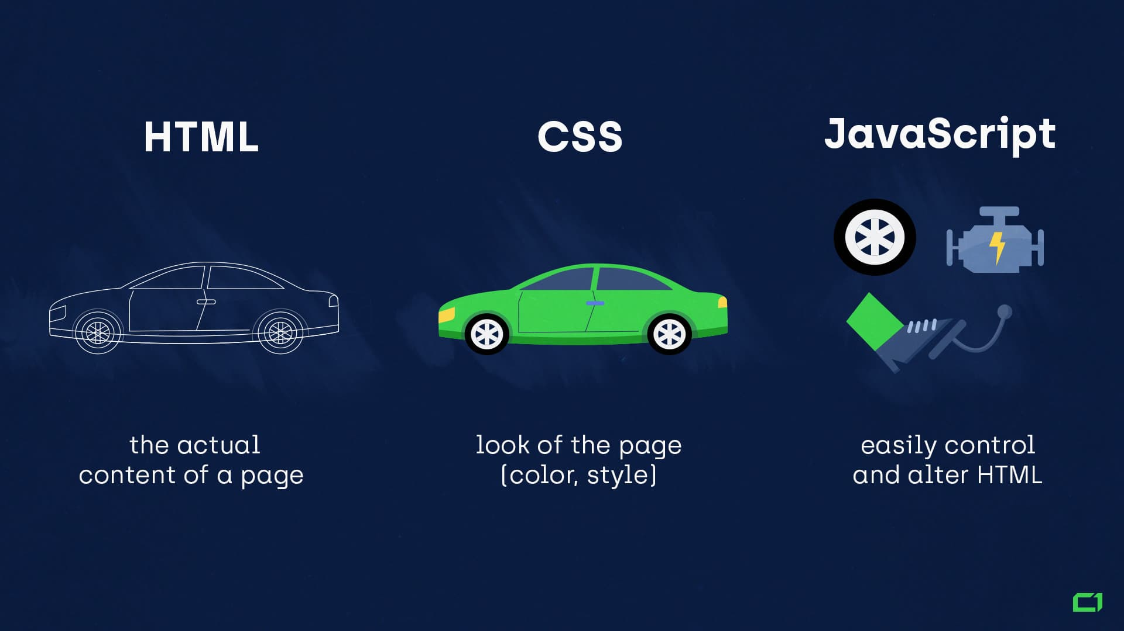
JavaScript Program that runs “inside” the browser

Slide 21
Our first Chrome Extension
Source: https://shiffman.net/a2z/chrome-ext/

Slide 22
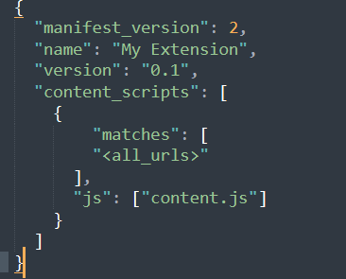
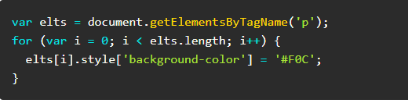
Our first Chrome Extension
Using Sublime Text create the following files
manifest.json
content.js
Save them in the same folder
content.js
This is the code to modify the HTML pages
manifest.json

Slide 23
Our first Chrome Extension
Go to “chrome://extensions/” in your Chrome Browser
Turn on Developer Mode
Click on ‘Load Unpacked’ and navigate to your folder
Now all <p> tags should be pink!!!
Try changing colors, text weight of other tags!

Slide 24
Other text alterations
document.body.innerHTML = document.body.innerHTML.replace(/Michigan/g, "Mars");
Will change all occurrence of ‘Michigan’ to ‘Mars’

